Slide 1
DEPARTMENT OF MECHATRONICS
Single Image Lens Flare Removal Using Deep Learning Techniques
B.Tech Final Project 2022 Presentation
Amulya Prashant Karkal (180929142)
Aryan James Philip (180929144)
Under the guidance of
Dr ASHA C S Associate Professor

Slide 2

CONTENTS
INTRODUCTION
LITERATURE REVIEW AND OBJECTIVES
METHODOLOGY
OBSERVATION AND CONCLUSION
REFERENCES
PROJECT MANAGEMENT

Slide 3
INTRODUCTION
DIFFERENT TYPES OF IMAGE DISTORTION
CAUSES OF LENS FLARE
WAYS TO AVOID LENS FLARE

Slide 4
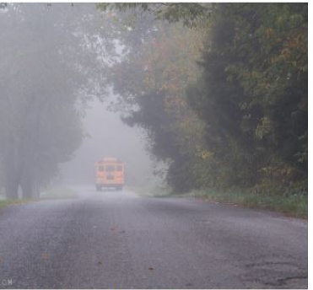
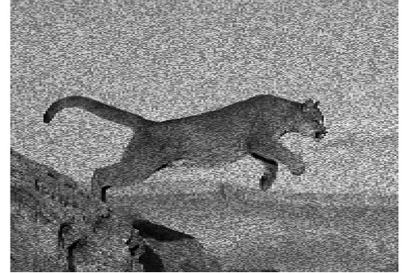
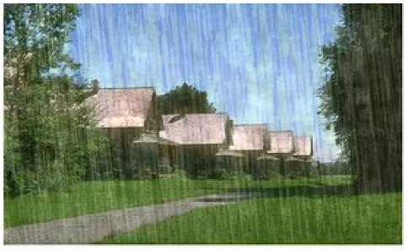
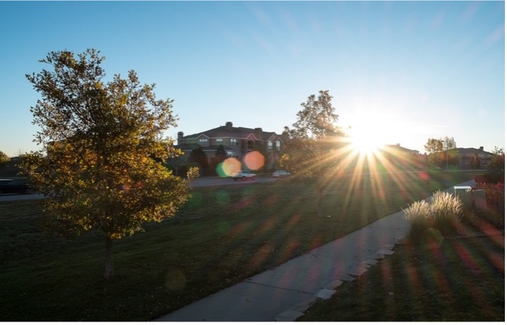
DIFFERENT TYPES OF IMAGE DISTORTION
Fig 1. Hazy image captured due to foggy weather
Fig 2. An image with white noise
Fig 3. The image was taken in the rain
Fig 4. Image with a sun flare

Slide 5
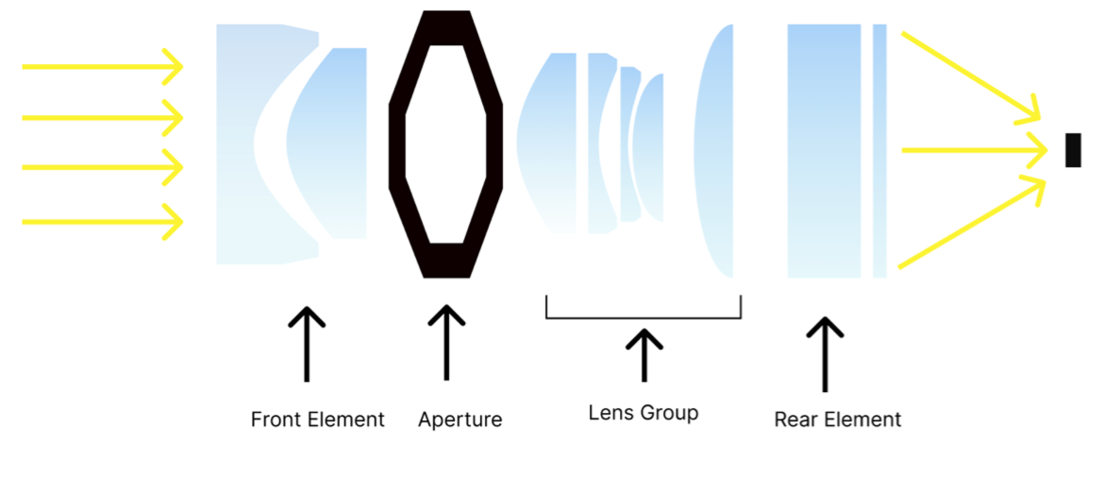
CAUSES OF LENS FLARE
Fig 5: Camera Lens

Slide 6
WAYS TO AVOID LENS FLARE
ANTIREFLECTIVE LAYER
AVOID THE SOURCE
CLEAN LENS

Slide 7

LITERATURE REVIEW

Slide 8
Table 1: Previously published papers on Flare Removal
Authors | Article | Journal | Salient Features
A. Criminisi, P. Perez and K. Toyama | Region Filling and Object Removal by Exemplar-based Image Inpainting | IEEE Transactions on Image Processing, 2004 | Identify patch Computing patch priorities Propagating texture and structure information. Updating confidence values
Patricia Vitoria and Coloma Ballester | Automatic Flare Spot Artifact Detection and Removal in Photographs | Journal of Mathematical Imaging and Vision 2019 | Characterizations of flares Determination of the flare region Removal of flares using exemplar-based inpainting
Wu, Y., He, Q., Xue, T., Garg, R., Chen, J., Veeraraghavan, A., & Barron, J. T. | How to train Neural Networks for Flare Removal | In Proceedings of the IEEE/CVF International Conference on Computer Vision, 2021 | Creating synthetic dataset Training using CNN Editing the resulting image PSNR = 25.55, SSIM = 0.85
Xiaotian Qiao GerhardP.Hancke Rynson W.H | Light Source Guided Single-Image Flare Removal from Unpaired Data | ICCV 2021 | Unpaired dataset Detection of light source Removal of flares PSNR = 21.57, SSIM - 0.812

Slide 9
OBJECTIVES
Appreciate the usage of images in one's day-to-day life and in the professional world. Analysing the different ways to solve the problem definition by researching all the previous methods that have been used to achieve it.
Create a dataset of standard images with different flares synthetically added to them. Arrange the dataset so that the ground truth images are in pairs with the synthetically generated ones for better comparison purposes. Further, create a GAN model to train the dataset.
Using various methods to calculate the error for comparing the model's accuracy with the previously used models.

Slide 10

METHODOLOGY

Slide 11
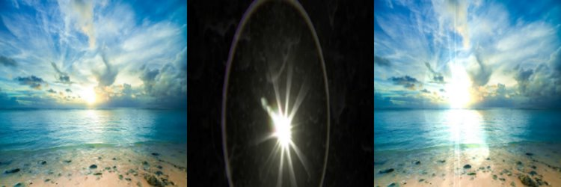
Dataset Collection
The Dataset was collected using paired synthetic flare and non-flared images. The flares were superimposed on the ground truth using a weighted function. A collection of 11388 images was used, which contained paired images of various flares.
Fig 6: Flare pre-sets are superimposed on ground truth images to give flared images. This was done for 11388 images.​

Slide 12
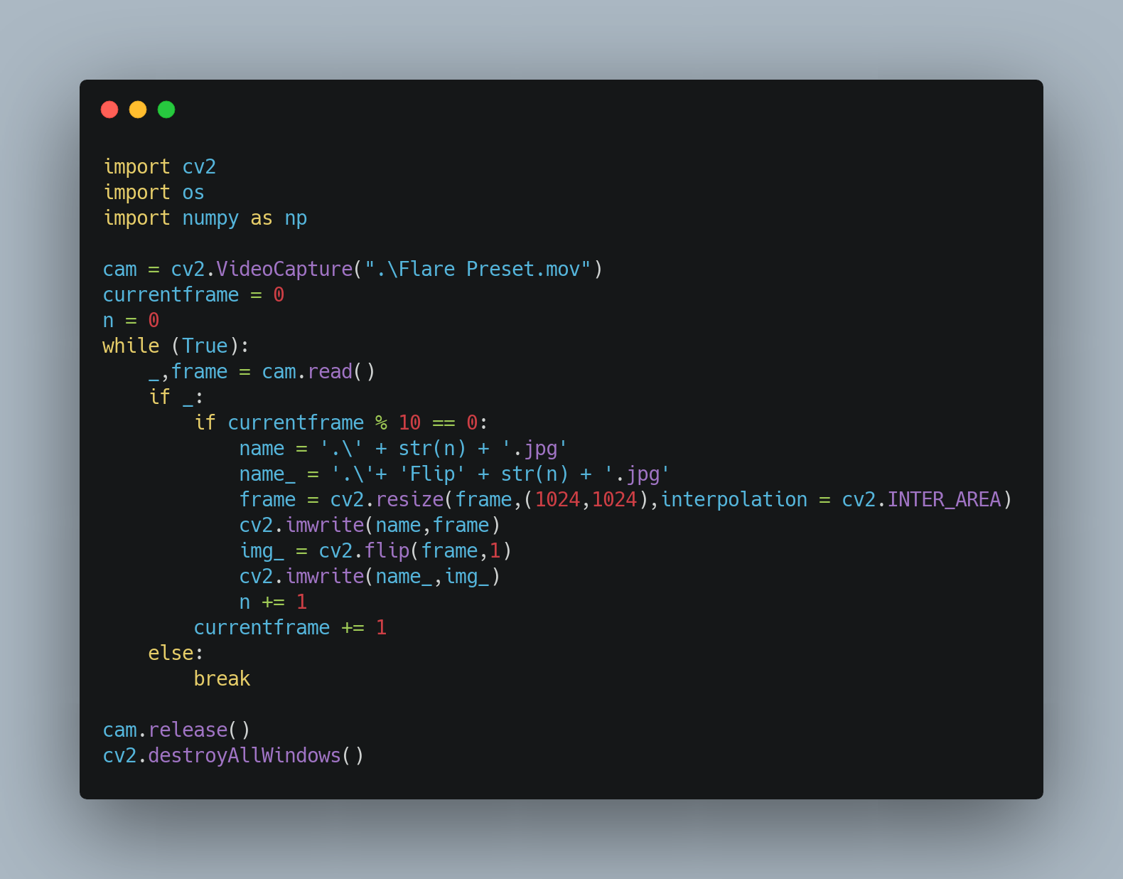
This Code was used to extract flares from an mp4 video consisting of different types of solar flares. Flares in every 10 frames were collected and were further annotated. The images were then resized to 1024x1024 and stored for further processing. These are the flare presets.
Fig 7: Code snippet for flare extraction

Slide 13
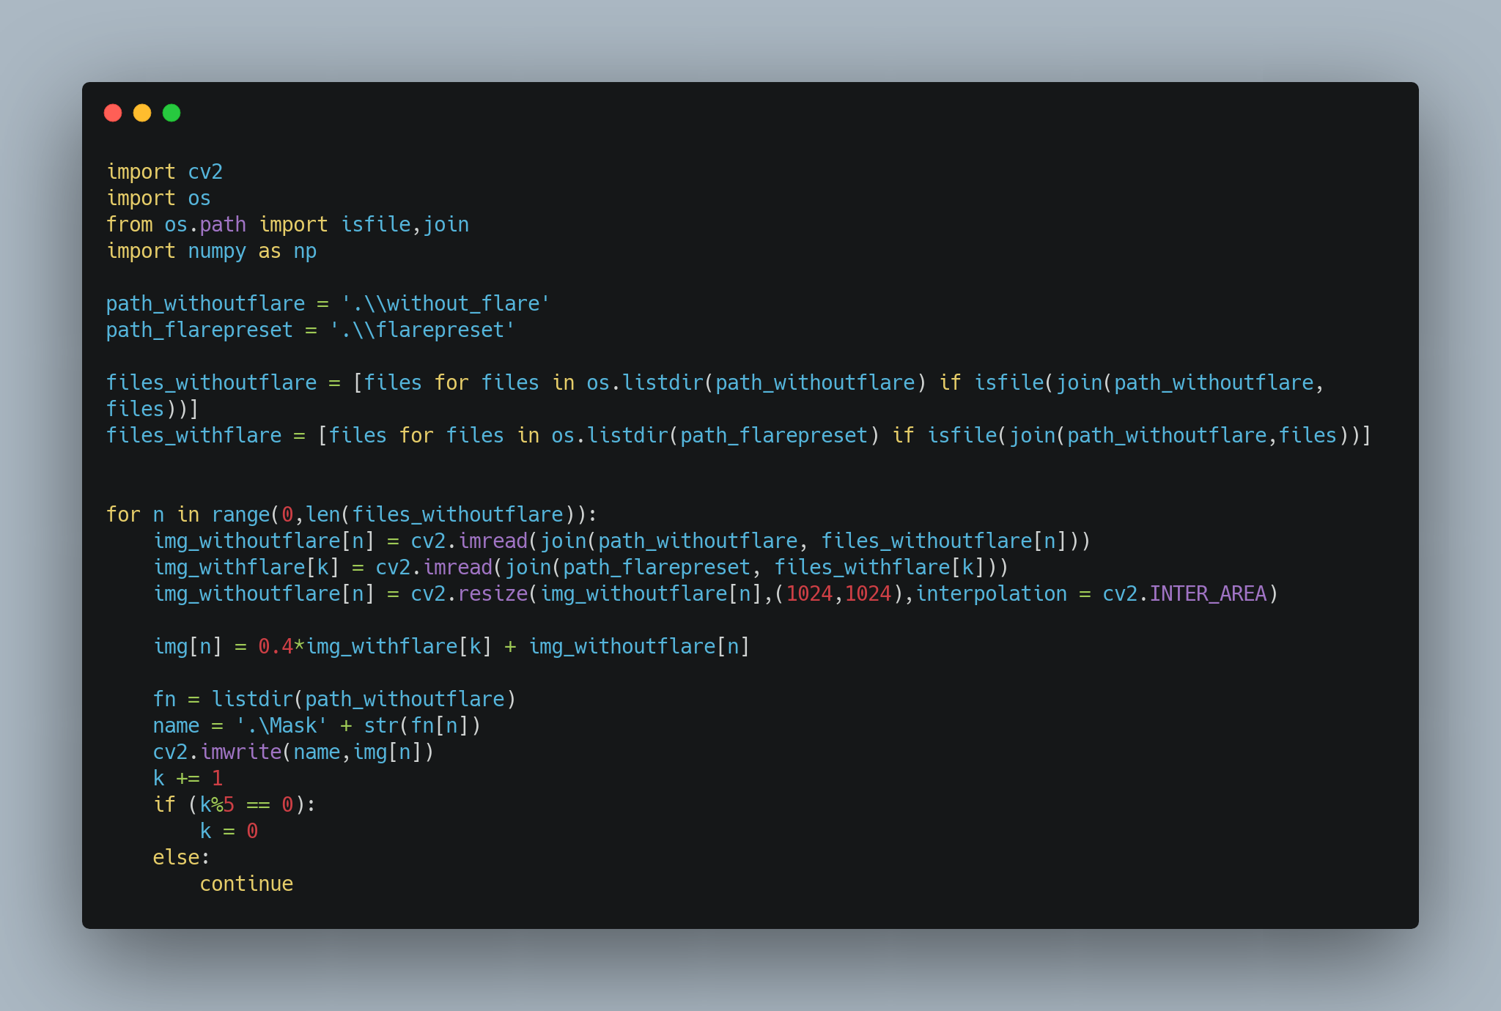
This Code was used to superimpose the flare presets and the ground-truth image using a weighted function to prevent the flare from being overexposed. The images are then resized and stored as masks or synthetically generated flared images.
Fig 8: Code snippet for flare superimposition

Slide 14
Data Loader
The Images were loaded into pairs with the flare and corresponding ground truth image stored in a dictionary.
To create a method to easily load the images into the model, a torch Dataset was used.
Transformations like resized crop, jitter, and normalizing of each channel were done to augment the dataset.
A batch size of 4 was used along with images with dimensions:
(4,256,256,3).

Slide 15
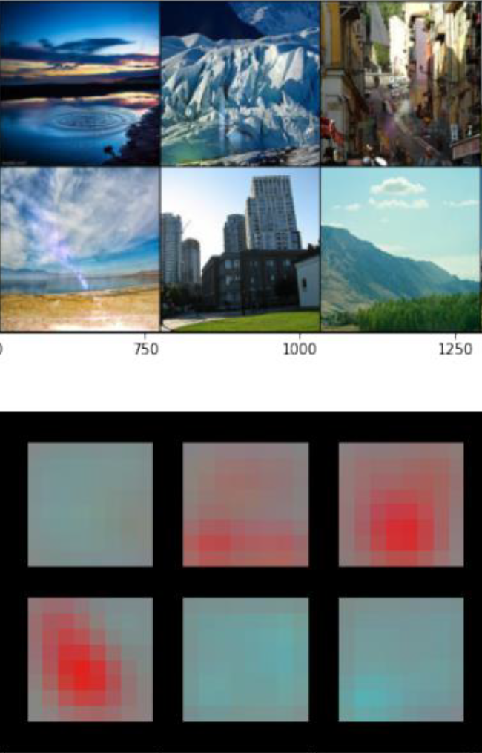
Feature Extractor
A feature extractor is essential to build the reconstruction loss used in the Generative Adversarial Networks(GAN) for flare removal. We need to test a variety of Deep Convolutional Neural Networks (DCNN) to decide which feature extractor works best.
Fig 9: Features from flared images were extracted and will be used to build the reconstruction loss for flare extraction.​ This heatmap is extracted from a dataset from flared and non-flared images.

Slide 16
Feature Extractor
We tested 5 State of the art (SOTA) architectures:
Table 2: A comparison of five feature extractors
Methods | Precision | Recall | F1 Score | Accuracy
Alex Net | 91.8 | 91.5 | 91.3 | 91.65
Mobile Netv2 | 97.6 | 96.9 | 97.2 | 97.3
ResNet18 | 98.4 | 95.36 | 96.64 | 96.82
Squeeze Net | 94.3 | 92.5 | 93.3 | 93.3
VGGNet | 97.8 | 94.8 | 96.9 | 96.2

Slide 17
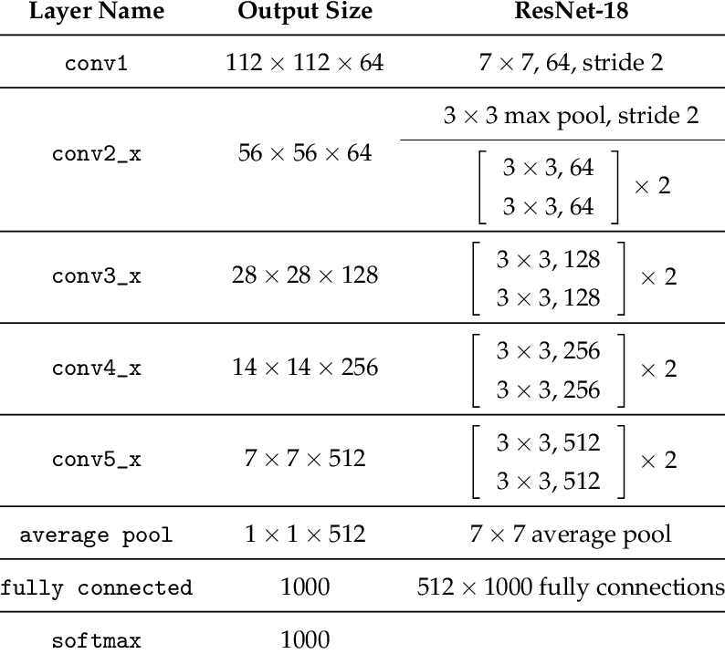
ResNet 18
Table 3: ResNet 18 architecture
ResNet 18 uses residual blocks to prevent losing low-level features and enhances the features before the fully connected layers. ResNet 18 was chosen over other networks because it is easy to implement and prevents vanishing gradients. MSE was used to store the Euclidean pixel distance.

Slide 18
Flare Removal Algorithm
Generator - encoder-decoder-based network similar to UNET*
Discriminator - PatchGAN
Architecture - Guided-Pix2Pix**
Loss Feature Extraction - ResNet
*N. Ibtehaz and M. S. Rahman, “Multiresunet: Rethinking the u-net architecture for multimodal biomedical image segmentation,” Neural Networks, vol. 121, pp. 74–87, 2020
**Jiao, Libin & Hu, Changmiao & Huo, Lian-Zhi & Tang, Ping. (2021). Guided-Pix2Pix: End-to-End Inference and Refinement Network for Image Dehazing. IEEE Journal of Selected Topics in Applied Earth Observations and Remote Sensing. PP. 1-1. 10.1109/JSTARS.2021.3061460.

Slide 19
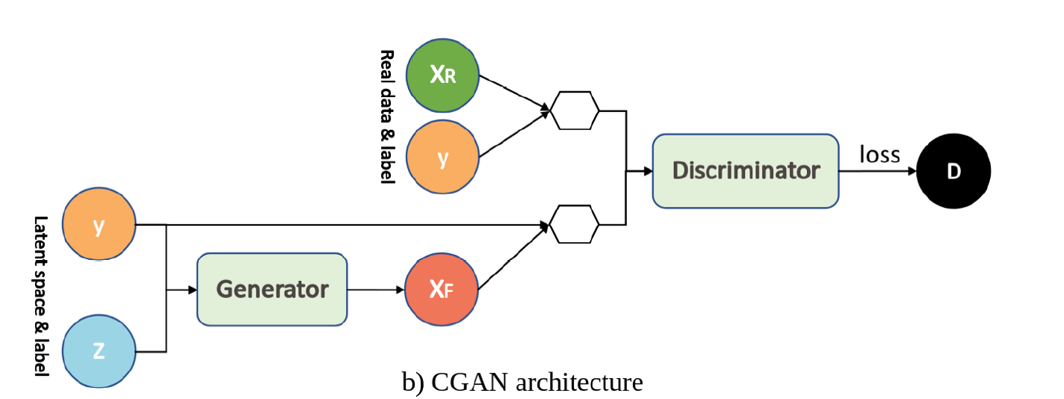

Conditional Generative Adversarial Network(CGAN)
Fig 10: A generalized CGAN architecture.

Slide 20
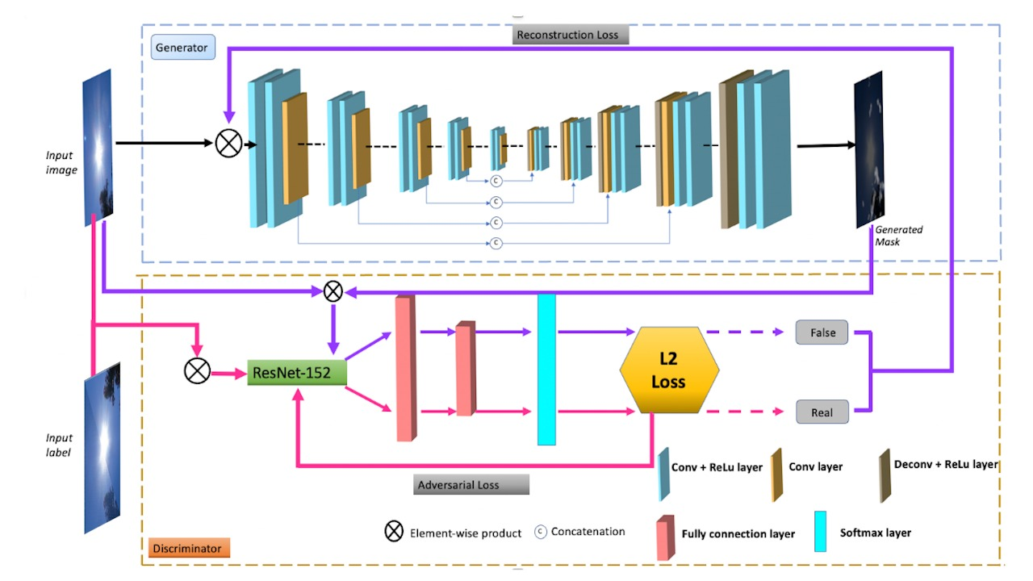
Flare Removal Algorithm
Fig 11: CGAN architecture that was used for flare removal

Slide 21
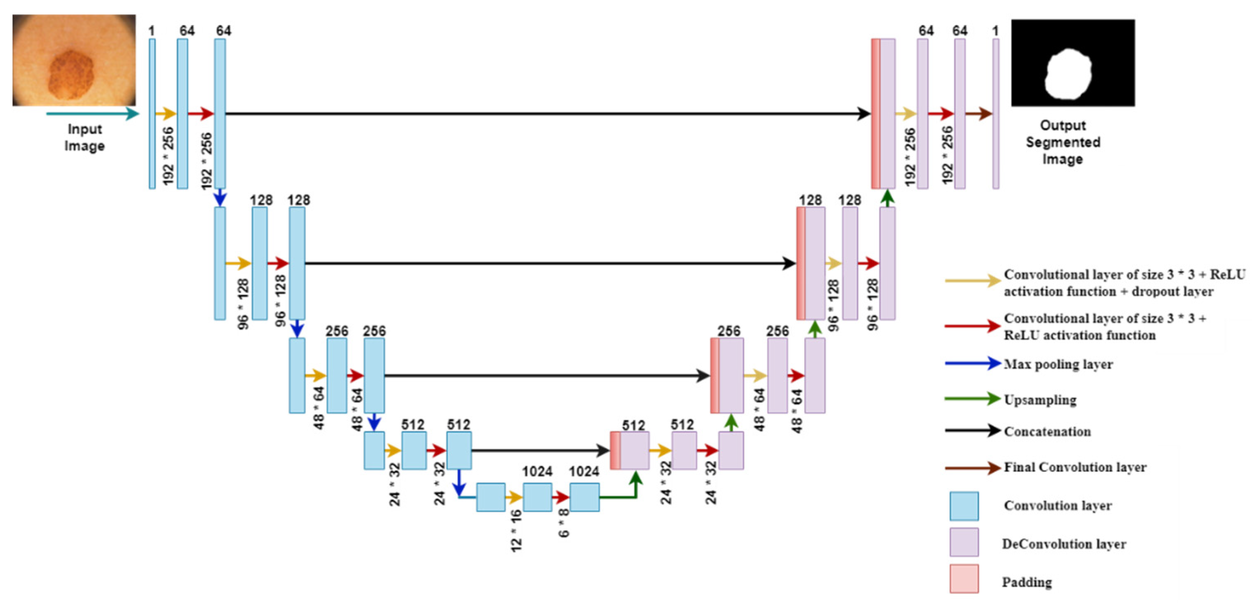
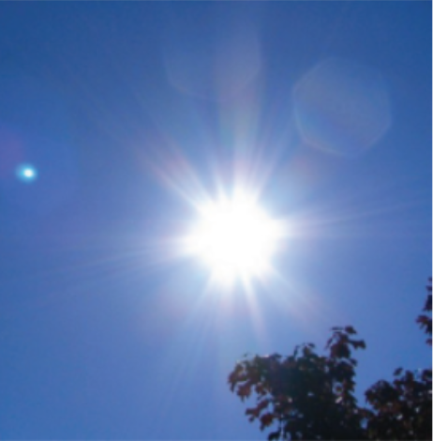
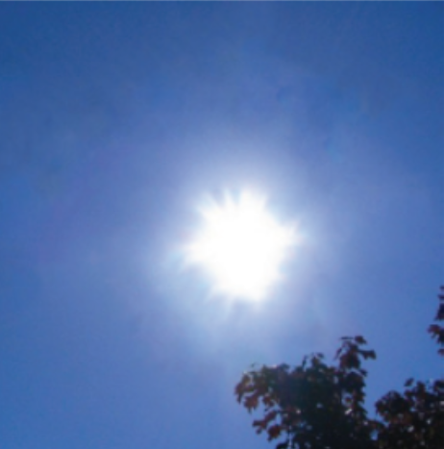
Generator Architecture
The encoder-decoder architecture consists of
Encoder: C64-C128-C256-C512-C512-C512-C512-C512.
U-Net decoder: CD512-CD1024-CD1024-C1024-C1024-C512 -C256-C128
The U-Net architecture is identical except with skip connections between each layer.
Skip Connections
Input Image
Generated Image
Fig 12: Generator Architecture U-Net. These architectures follow an encoder-decoder structure with skip connections to enhance low-level features.

Slide 22
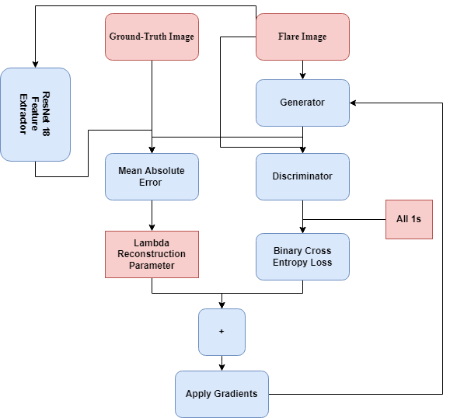
Updating Weights in the Generator
The weights of the generator are updated using the objective function of the Discriminator which tries to maximize the objective function.
Fig 13: Updating weights of a generator.

Slide 23
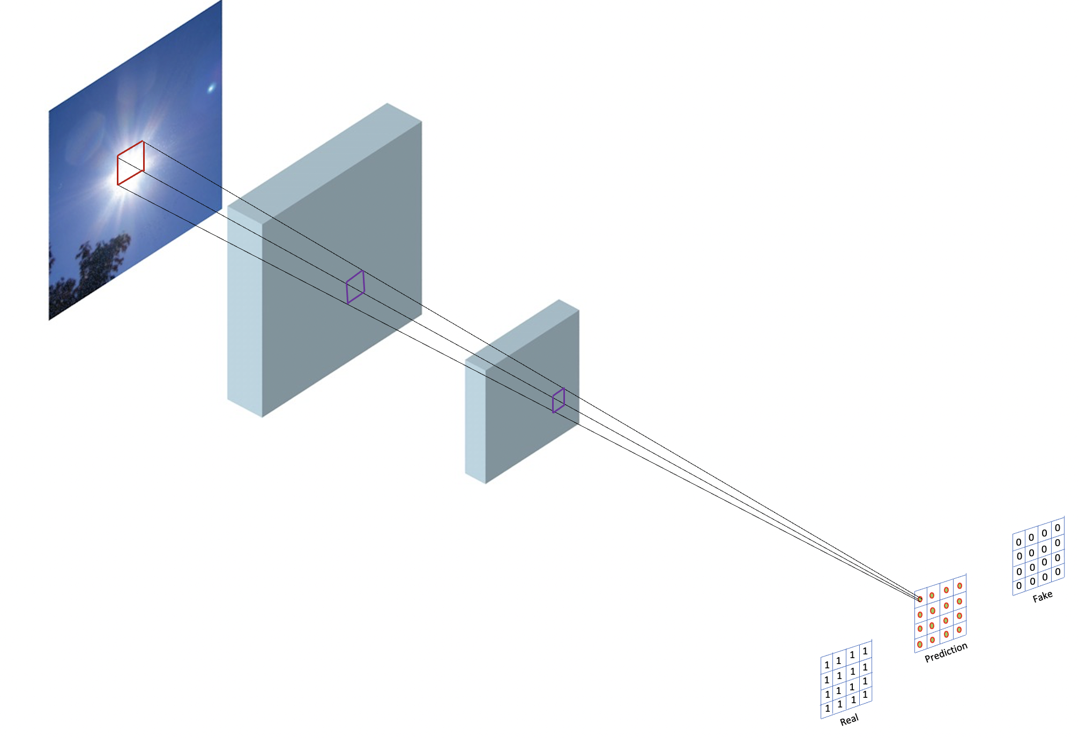
Discriminator Architecture
The PatchGAN discriminator works by considering only 70x70 local patches and then feeding it into a CNN into a 16x16 matrix wherein each element corresponds to the probability of the flare being present or not in the 70x70 patch. These probabilities are then compared with a matrix of ones and zeroes using Binary Cross-Entropy loss which is used to update the parameters of the discriminator.
Fig 14: The PatchGAN discriminator.

Slide 24
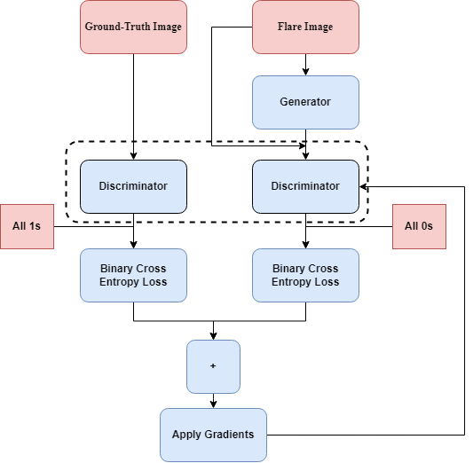
Updating Weights in the Discriminator
The weights of the discriminator are updated using the objective function of the Discriminator which tries to maximize the objective function. This becomes the adversarial component.
Fig 15: Updating Weights in the Discriminator

Slide 25
Flare Removal Training
Table 3: Specifications used while training
Method | Batch Size | Epochs | Generator L.R | Discriminator L.R | Optimizer | Adv. | Recon.
CGAN | 4 | 70 | 1e-5 | 1e-8 | Adam | BCE | L1 loss
VAE | 8 | 70 | 2e-4 | N/A | Adam | BCE | MSE

Slide 26
Losses
Usually using a GAN with a standard L2 loss results in strong artifacts and blurring. A Perceptual loss is essential to prevent the output image from being noisy. Essentially this is where our feature extractor comes into play, we use these to add a perceptual component to our loss function.
The above equation represents the combination of all loss functions. α and β are hyperparameters and their sum should be approximately 1.

Slide 27
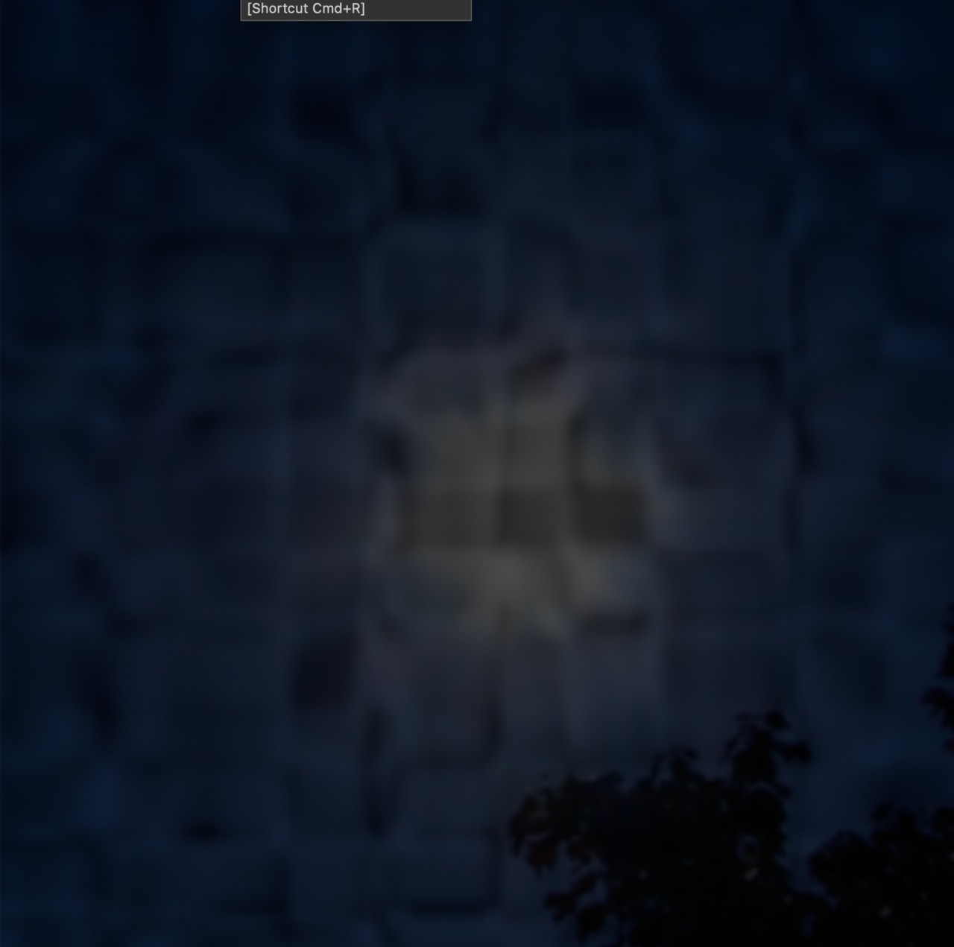
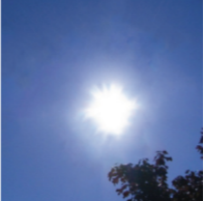
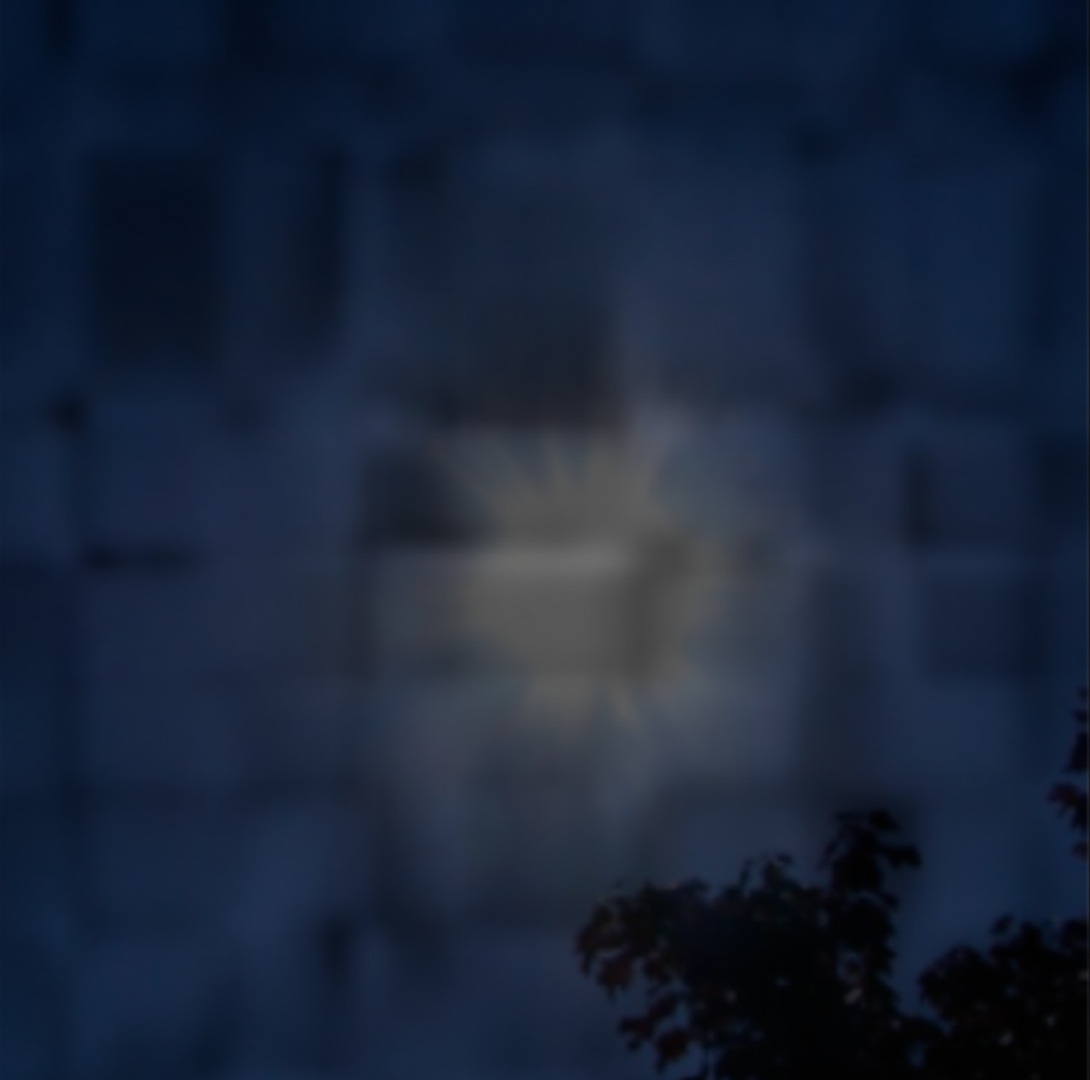
Choosing and
We determined the value of the hyperparameters using experimental means. We tested three ratios and found that 8:2 produces the best results. Some of the results are shown below.
(a)
= 50
(b)
= 80
(c)
= 60
= 50
= 20
= 40
Fig 16: Representation of different values of α and β and choosing the best one.

Slide 28
Generator Loss
Generator Loss is essential because it performs a dual role. It not only has to fool the discriminator but also be close to the ground truth in the L2 norm sense. This makes it essential for the Generator to perform without overfitting as well as reducing the loss between the generator output and the ground-truth image.
The above equation represents the distance between the features extracted from the generator o/p and the ground truth using ResNet. α (alpha) is a hyperparameter that is derived experimentally. A value of 0.8 was chosen as it has been extensively tested* and it was the best value.
*Lucas, Alice, et al. "Generative adversarial networks and perceptual losses for video super-resolution." IEEE Transactions on Image Processing 28.7 (2019): 3312-3327.

Slide 29
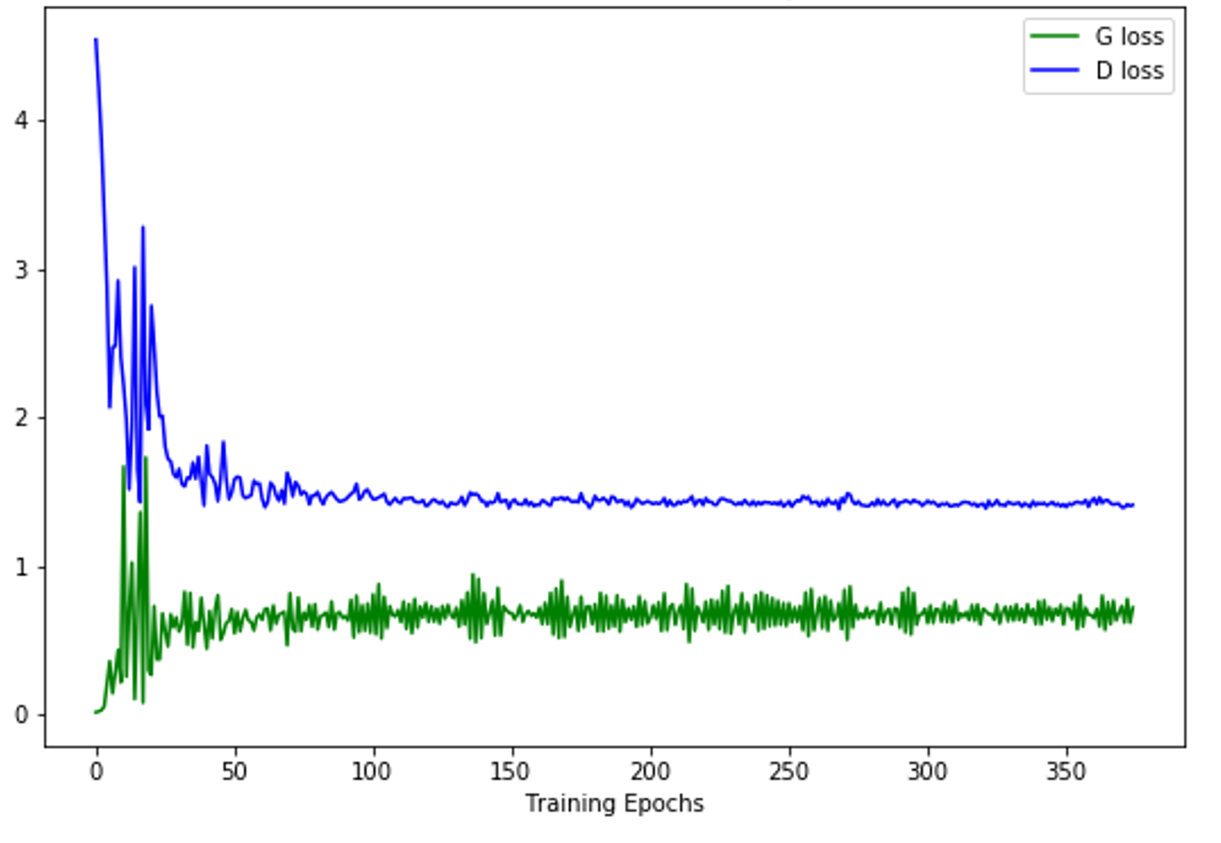
Discriminator Loss
This loss has to perform an adversarial role to feed the BCE loss back into the generator. This feedback is essential for the generator to produce better output to fool the discriminator. The discriminator seeks to maximize the probability assigned to real and fake images.
Fig 17: The Generator and Discriminator loss.

Slide 30
Metrics for Flare Removal
Metrics play an important role in pix2pix especially it aids in setting up important baselines for comparing results from different algorithms and architectures.
In current literature, there exist 2 main metrics for comparison:
Peak Signal to Noise Ratio (PSNR)
Structural Similarity Index (SSIM)
The above metrics are full reference metrics i.e., they require paired images.
There are certain no reference metrics, but they are application-specific.
3. Spectral Entropy-based Quality (SSEQ)

Slide 31
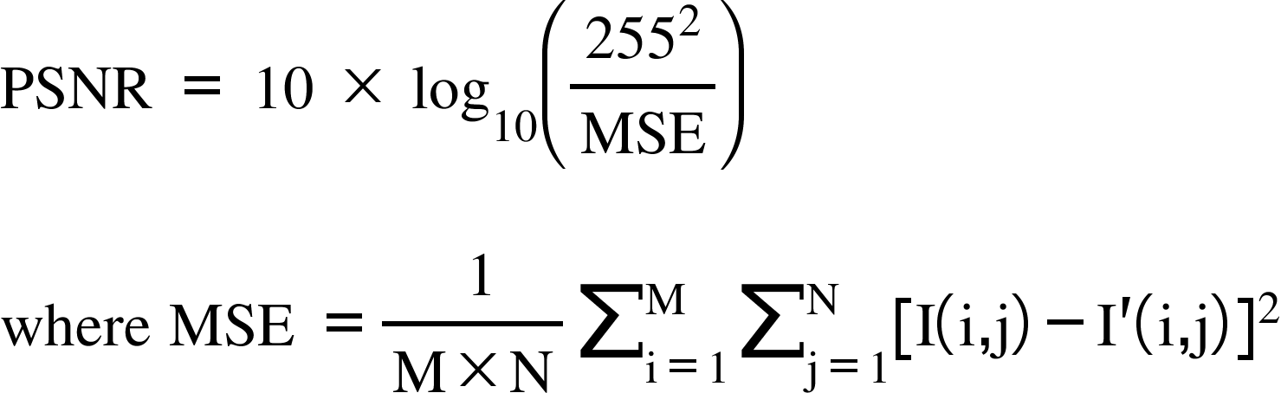
Peak Signal to Noise Ratio (PSNR)
Peak Signal to Noise ratio is a very important metric to calculate the ratio between the maximum possible power of an image and the corrupting noise that affects the quality of its representation.
It is inversely dependent on the log inverse of the Mean Square Error (MSE) and is necessary to compare an image to an ideal output image with the maximum possible power.

Slide 32
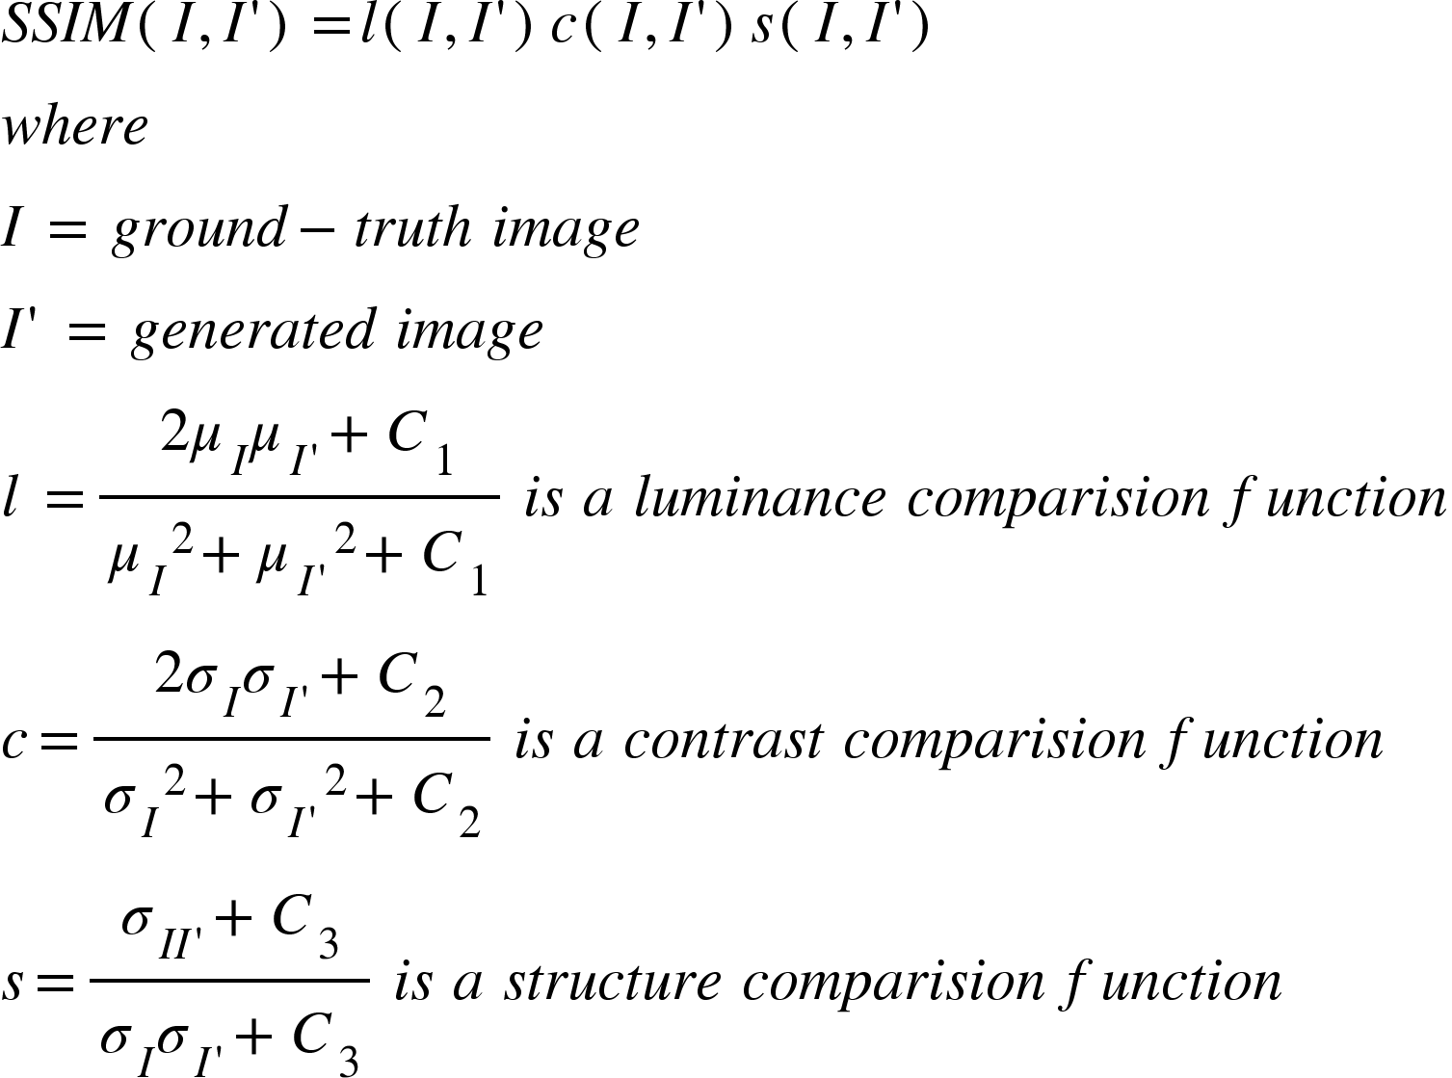
Structural Similarity Index(SSIM)
Structural Similarity Index is more of a perceptual metric that quantifies image quality degradation caused by processing such as data compression or by losses in data transmission.
This metric wholly relies on the ground truth image and the output of the flare removal model making it a full reference metric. Since this metric is based on the Human Visual System (HVS), It is a more reliable metric as compared to PSNR.

Slide 33
Spectral Entropy-based Quality (SSEQ)
This metric is a no-reference metric that measures the change in spatial/spectral information in an image. Since this is a metric that doesn’t require a corresponding ground truth, it becomes a vital metric to progress flare removal. However, this metric usually results in varying degrees of accuracy, hence, not making it robust enough to use in most scenarios. Additionally, this metric is not open-source and the source code isn’t readily available to most and is application-specific. We haven’t done comparisons using this metric and is left open for further development.

Slide 34
Comparison
To build a robust algorithm, we need to compare our methods with preexisting ones. We tested a variety of other algorithms which were built for applications like dehazing, denoising, and deraining as well as some other GAN models like cycle GAN. We mainly considered cycle GAN and FFA net due to extensive research and documentation available on these 2 algorithms.
Five Algorithms were tested, and their metrics were analyzed:
Cycle GAN
FFA net
HI net
NAF net
GMAN net

Slide 35
Table 4: Quantitative analysis of the methods
Methods​ | Test Images​ | PSNR​ | SSIM​
Cycle GAN​ | 50​ | 21.6​ | 0.812​
FFA net​ | 50​ | 18.9​ | 0.796​
HI-Net​ | 50​ | 18.2​ | 0.782​
NAF Net​ | 50​ | 18​ | 0.784​
GMAN Net​ | 50​ | 18​ | 0.80​

Slide 36
NOVELTY
From the work proposed for flare removal, we have improved existing architectures by the following methods:
We have collected a large dataset of synthetic images and have added a variety of flares so that the model generalizes better.
We have modified the loss function to use ResNet as the feature extractor instead of the previously used VGG16/19. Additionally, we have used hyperparameters to tune the loss function.
We have analyzed our model with pre-existing dehazing and deraining models for comparison purposes.

Slide 37
PROJECT MANAGEMENT

Slide 38
CONTRIBUTIONS
Aryan James Philip • Existing Solutions Review: Studied and analyzed existing solutions in flare removal, denoising, dehazing, and deraining.
• Model Building: Built the model for the U-net, discriminator and tested various combi- nations of Pix2Pix.
• Model Analysis and Comparison: Set up baselines for comparing models and documented the code and setup.
• Dataset Analysis: Did a deep dive into dataset and analyzed various parameters.
Amulya Prashant Karkal • Existing Solutions Review: Studied previously published reports on flare removal, dehazing, denoising, and deraining.
• Testing: Ran multiple flare removal architectures on the synthetic dataset that was made.
• Comparison: Ran multiple dehazing, denoising, and deraining architectures on a reduced dataset to form comparisons with the dataset we created.

Slide 39
PROJECT TIMELINE
2 Months - (February - March)
Reading up on existing literature Building a synthetic dataset Algorithm Design Loss function and Feature Extractor
2 Months (April - May)
Algorithm Testing Model Comparison Metric Comparison Report Writing

Slide 40

OBSERVATIONS AND CONCLUSION

Slide 41
OBSERVATIONS
In the current scenario of flare removal, we achieved better results than some of the pre-existing solutions, however, our results are admirable only for certain kinds of images. Our model works well with images having less information and other complex features but falls short especially with images having a lot of high-level features.
Since the model was tested by using synthetically generated images, it performs quite poorly on natural images. However, it becomes extremely difficult to generalize across all images and results are varied.
Loss Function was to be devised
Post-processing rectification is required since discoloration was observed after flare removal

Slide 42
Results
We tested our algorithm on our dataset as well as a famous ‘place 365’ dataset which contains natural images and compared the metrics:
Table 5: PSNR and SSIM values for two different datasets
Datasets | PSNR | SSIM | No of Images
Places 365 | 25.8 | 0.823 | 50
Custom | 28.4 | 0.859 | 50

Slide 43
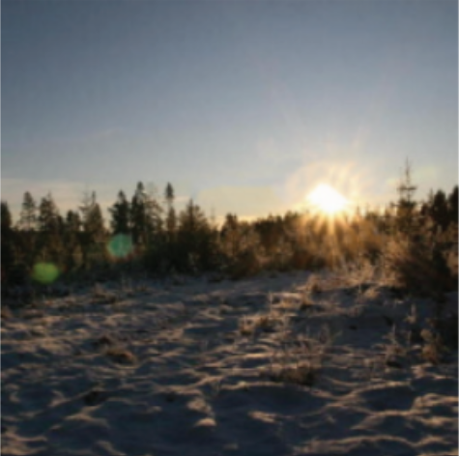
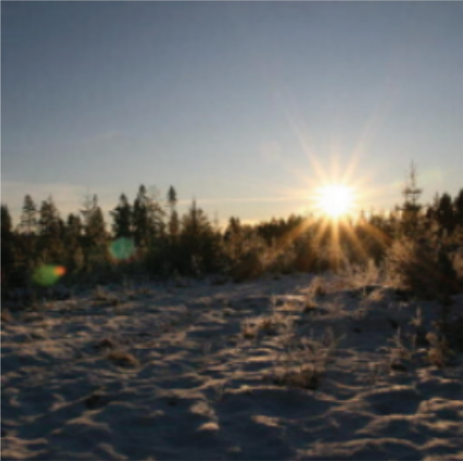
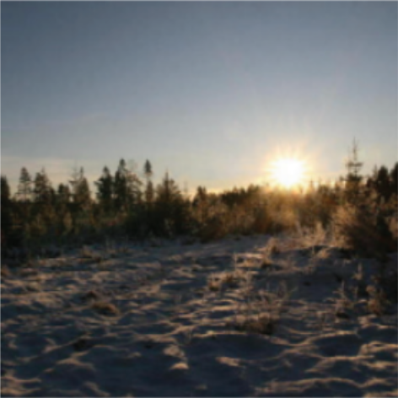
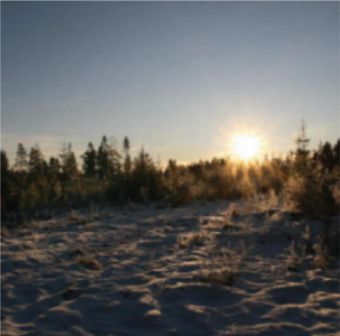
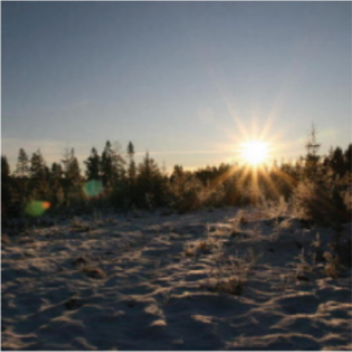
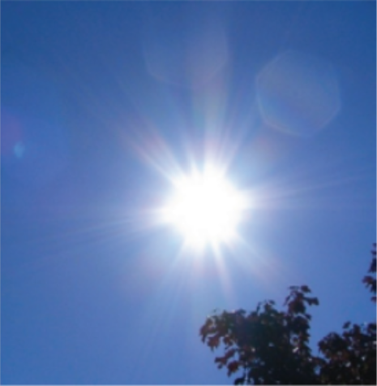
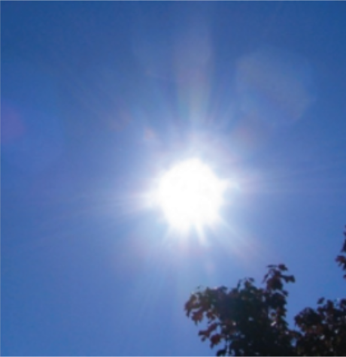
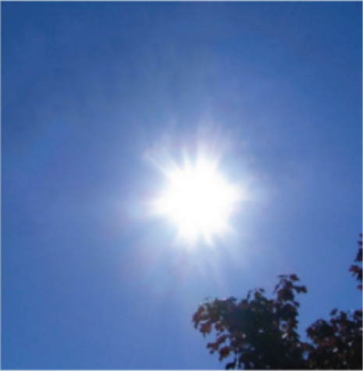
Results
FFA
Cycle GAN
Our Network
Ground Truth
Input
FFA
Cycle GAN
Our Network
Ground Truth
Input
Fig 18: Results of 3 models

Slide 44
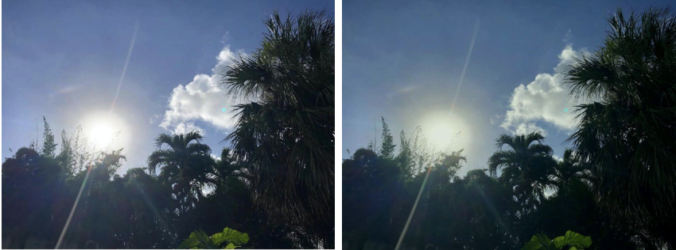
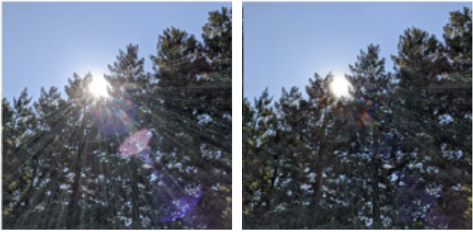
Results
Input
Output
Fig 19: FFA net
Input
Output
Fig 20: Cycle GAN

Slide 45
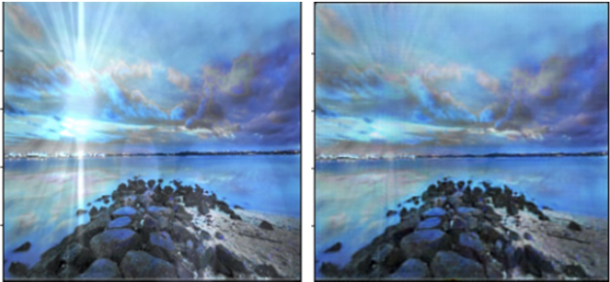
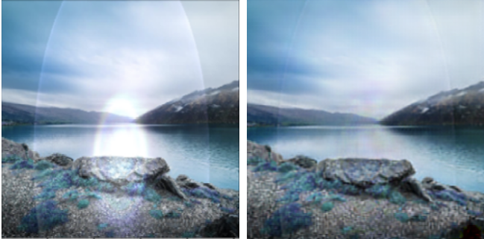
Results
Input
Output
Fig22: HI net
Input
Output
Fig 21: NAF net

Slide 46
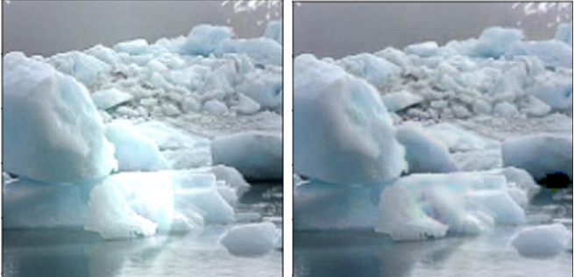
Results
Input
Output
Fig 22: GMAN net

Slide 47
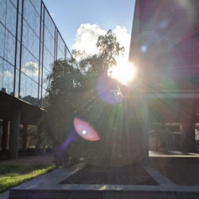
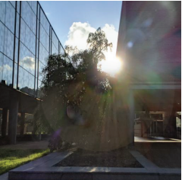
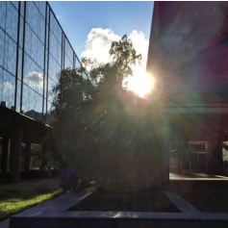
Result Analysis
The work proposed by us was trained across multiple scenes and different types of flares, it is able to robustly remove lens flares of various shapes, colors, and locations on diverse synthetic images. It even generalizes to multiple light sources. Compared to other methods like cycle GAN and FFA net.
Input
Cycle GAN
Ours
Fig23: Comparing our model across multiple sources.

Slide 48
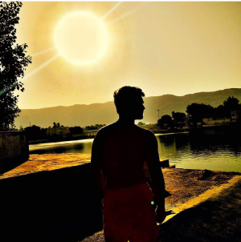
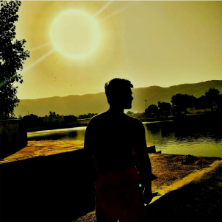

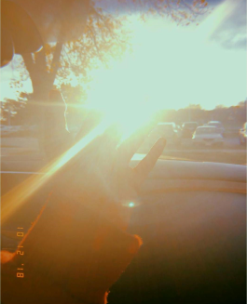
Failure Cases
After broad testing, we have noticed certain cases where our model fails to remove flares. These scenes are where the light source is too bright, or the flares come from a barely visible light source and is disjointed.
Input
Output
Input
Output
Fig 24: Failure case when the flare and light source are disjointed.
Fig 24: Failure case when the light source is too bright.

Slide 49
CONCLUSION
Through this study, a thorough comparative analysis of the SOTA models is presented.
This work considered traditional metrics such as PSNR and SSIM on a completely new dataset generated synthetically.
The work proposed is novel as additions were made upon previous works by improving the loss function and doing a deep analysis of the feature extraction process.
There is still a long way to go in terms of model training, evaluation, image sizes and building an end-to-end pipeline for flare removal.

Slide 50
REFERENCES
[1] A. Criminisi, P. Perez, and K. Toyama, “Region filling and object removal by exemplar- based image inpainting,” IEEE Transactions on Image Processing, vol. 13, no. 9, pp. 1200–1212, 2004. DOI: 10.1109/TIP.2004.833105.
[2] S. Lee and E. Eisemann, “Practical real-time lens-flare rendering,” in Proceedings of the Eurographics Symposium on Rendering, ser. EGSR ’13, Zaragoza, Spain: Eurographics Association, 2013, pp. 1–6. DOI: 10. 1111 / cgf. 12145. [Online]. Available:https://doi.org/10.1111/cgf.12145.
[3] P. Vitoria and C. Ballester, “Automatic flare spot artifact detection and removal in photographs,” Journal of Mathematical Imaging and Vision, vol. 61, no. 4, pp. 515–533,2019.
[4] Y. Wu, Q. He, T. Xue, et al., “How to train neural networks for flare removal,” in Proceedings of the IEEE/CVF International Conference on Computer Vision, 2021, pp. 2239–2247.
[5] X. Qiao, G. P. Hancke, and R. W. Lau, “Light source guided single-image flare removal from unpaired data,” in Proceedings of the IEEE/CVF International Conference on Computer Vision (ICCV), Oct. 2021, pp. 4177–4185.
[6] Z. Liu, B. Xiao, M. Alrabeiah, K. Wang, and J. Chen, “Generic model-agnostic convolutional neural network for single image dehazing,” arXiv preprint arXiv:1810.02862,2018.
[7] X. Qin, Z. Wang, Y. Bai, X. Xie, and H. Jia, “Ffa-net: Feature fusion attention network for single image dehazing,” in Proceedings of the AAAI Conference on Artificial Intelligence, vol. 34, 2020, pp. 11 908–11 915.
[8] L.-C. Chen, Y. Zhu, G. Papandreou, F. Schroff, and H. Adam, “Encoder-decoder with atrous separable convolution for semantic image segmentation,” in Proceedings of the European conference on computer vision (ECCV), 2018, pp. 801-818.
[9] K. He, X. Zhang, S. Ren, and J. Sun, “Deep residual learning for image recognition,” in Proceedings of the IEEE conference on computer vision and pattern recognition, 2016, pp. 770–778
. [10] J.-Y. Zhu, T. Park, P. Isola, and A. A. Efros, “Unpaired image-to-image translation using cycle-consistent adversarial networks,” in Proceedings of the IEEE international conference on computer vision, 2017, pp. 2223–2232.
[11] M. A. Bagheri. “Conditional generative adversarial nets.” (2019), [Online]. Available:https://medium.com/@ma.bagheri/a-tutorial-on-conditional-generative-adversarial-nets-keras-implementation-694dcafa6282.(accessed: 20.05.2022).

Slide 51
THANK YOU

